Slide 1

Writing in Reception
Miss Janagil – Early years leader

Slide 2
EYFS Statutory Educational Programme 2021
EYFS Statutory Educational Programme: The development of children’s spoken language underpins all seven areas of learning and development.
Children’s back-and-forth interactions from an early age form the foundations for language and cognitive development.
The number and quality of the conversations they have with adults and peers throughout the day in a language-rich environment is crucial.

Slide 3
Writing at age 3-4 years
Use some of their print and letter knowledge in their early writing. For example: writing a pretend shopping list that starts at the top of the page; writing ‘m’ for mummy. Write some or all of their name.
Write some letters accurately.

Slide 4
What does this look like?
- Motivate children to write by providing opportunities in a wide range of ways. Suggestions: clipboards outdoors, chalks for paving stones, boards and notepads in the home corner. Children enjoy having a range of pencils, crayons, chalks and pens to choose from. Apps on tablets enable children to mix marks, photos and video to express meanings and tell their own stories. Children are also motivated by simple home-made books, different coloured paper and paper decorated with fancy frames.
- Help children to learn to form their letters accurately. First, they need a wide-ranging programme of physical skills development, inside and outdoors. Include large-muscle co-ordination: whole body, leg, arm and foot. This can be through climbing, swinging, messy play and parachute games, etc. Plan for small muscle co-ordination: hands and fingers. This can be through using scissors, learning to sew, eating with cutlery, using small brushes for painting and pencils for drawing. Children also need to know the language of direction (‘up’, ‘down’, ‘round’, ‘back’, etc)

Slide 5
Writing at age 4-5 years
Form lower-case and capital letters correctly.
Spell words by identifying the sounds and then writing the sound with letter/s.
Write short sentences with words with known sound-letter correspondences using a capital letter and full stop.
Re-read what they have written to check that it makes sense.

Slide 6
What does this look like?
-Support children to form the complete sentence orally before writing. Help children memorise the sentence before writing by repeatedly saying it aloud. Only ask children to write sentences when they have sufficient knowledge of letter-sound correspondences. Dictate sentences to ensure they contain only the taught sound-letter correspondences.
-Teach formation as they learn the sounds for each letter using a memorable phrase, encouraging an effective pen grip. When forming letters, the starting point and direction are more important at this stage than the size or position of the letter on a line.

Slide 7
Early Learning Goal – End of year
Children at the expected level will-
Write recognisable letters, most of which are correctly formed;
Spell words by identifying sounds in them and representing the sounds with a letter or letters;
Write simple phrases and sentences that can be read by others

Slide 8
What does this look like?
The child can write independently
They used phonics but can spell some words (Tricky words)
Child does not need adults to dictate what they need to write
You can read what has been written and the child can read back what they have been writing.

Slide 9
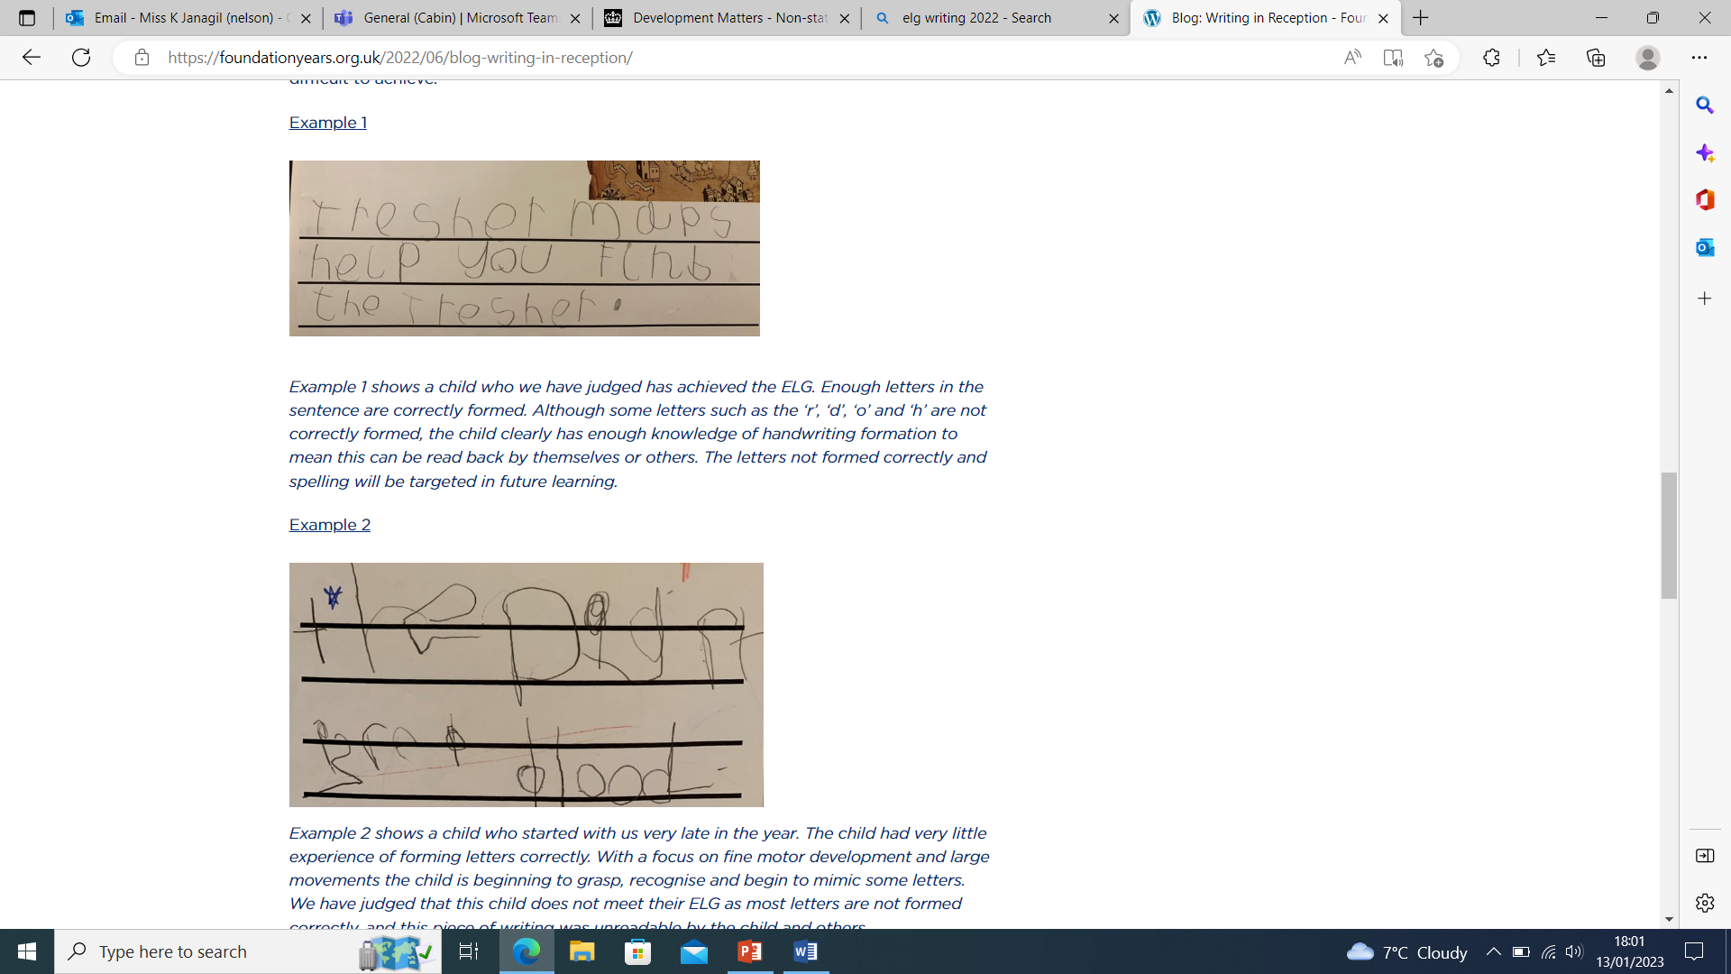

Slide 10
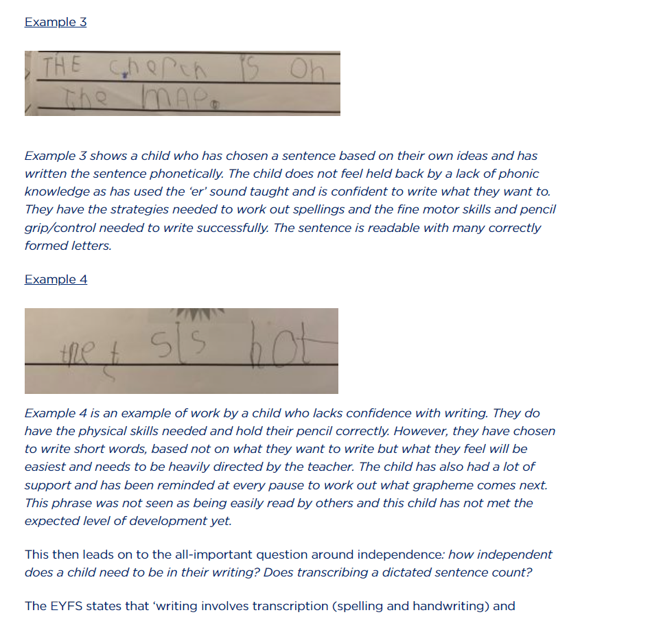

Slide 11
What can Impact writing development?
Phonics
Speaking and listening
Physical development (fine motor and gross motor skills)

Slide 12
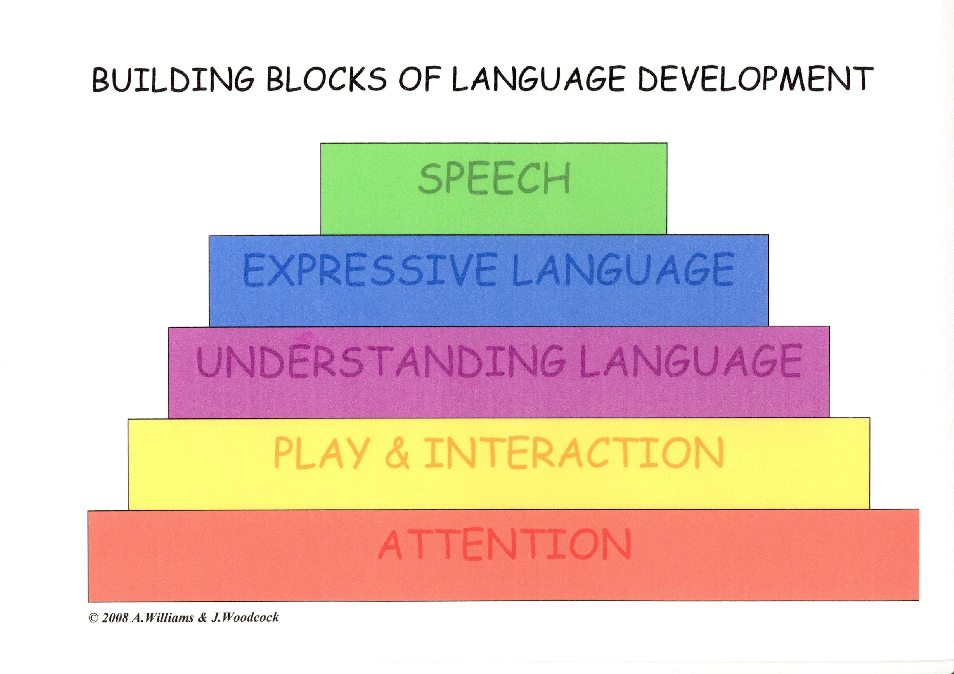

Slide 13
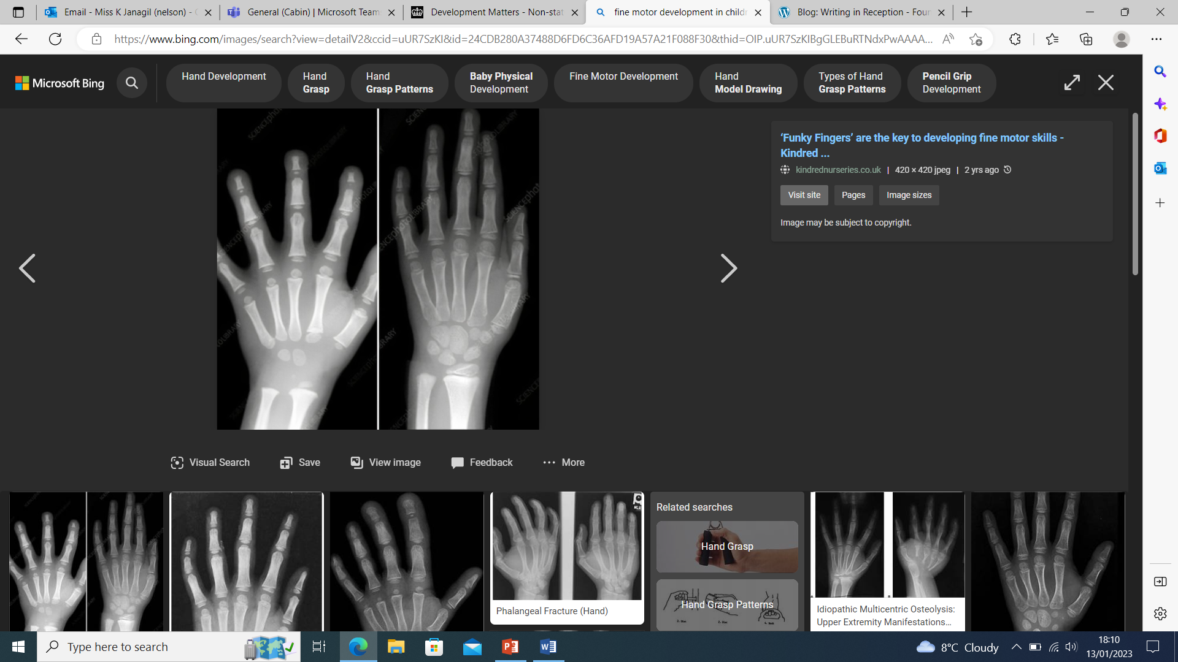
Psychical Development

Slide 14
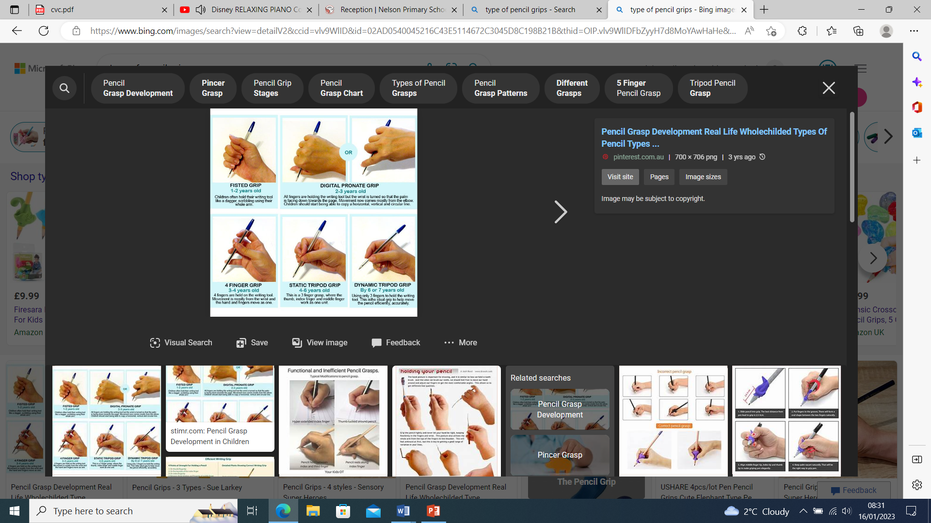

Slide 15
Phonics
They learn formation
Sounds and what sounds letters make
Tricky words to spell
20 minutes per day

Slide 16
Help at home
Giving children time to write and encourage use of phonics
Give them time to think of sentences
Let them write about what they like
Fun!!
Let them see you write at home
Letter formation

Slide 17
Activities on tables
Feel free to try the activities with your children
We will be walking around modelling how to use them and feel free to talk to us and ask any questions you may have.

