Slide 1

Supporting communication
Flourish speech and language therapy
Miss Janagil

Slide 2
EYFS Statutory Educational Programme 2021
EYFS Statutory Educational Programme: The development of children’s spoken language underpins all seven areas of learning and development.
Children’s back-and-forth interactions from an early age form the foundations for language and cognitive development.
The number and quality of the conversations they have with adults and peers throughout the day in a language-rich environment is crucial.

Slide 3
English as an additional language
Speaking more than one language has lots of advantages for children.
It is the norm in many countries around the world.
Children will learn English from a strong foundation in their home language.
We encourage you to use your home language for linguistic as well as cultural reasons.
Children learning English will typically go through a quiet phase when they do not say very much and may then use words in both languages in the same sentence.

Slide 4
What we can do at home & school
We encourage independence
Language rich environment where we encourage children to use their voice.
We give them time to respond and think about what they are saying.
We model language – Give them the answers!!
We promote activities that are just about language, talking, playing, having conversations.
We talk to parents about how they communicate with you at home.

Slide 5
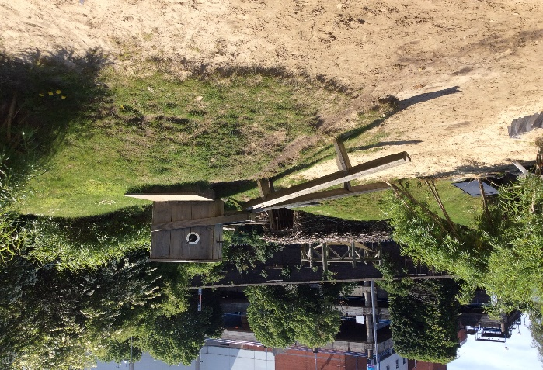
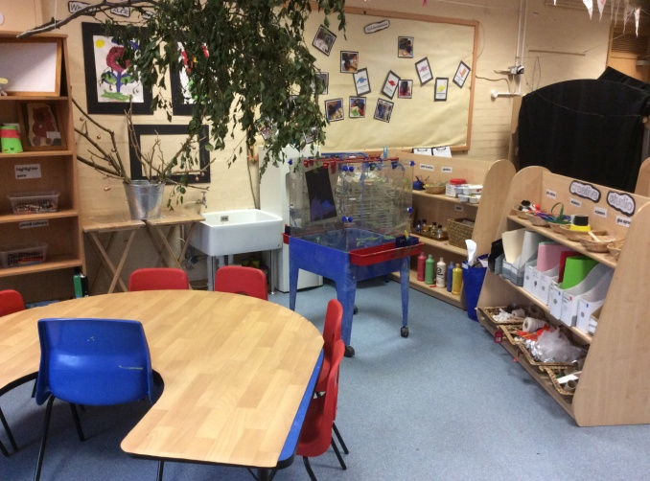
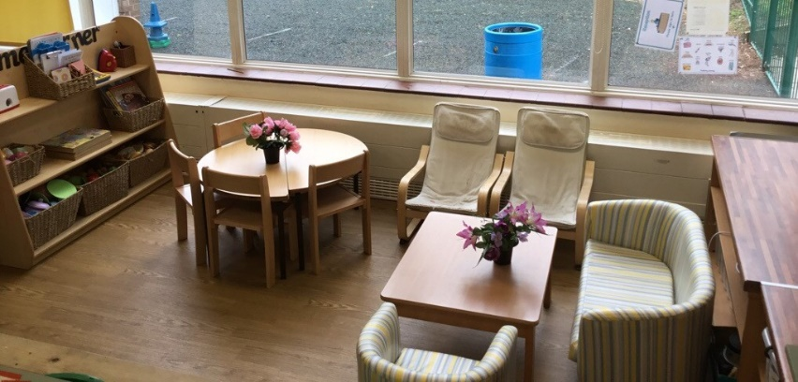
Everyday tasks – like helping to cook, reading books, talking about what they are watching on TV.
Imaginative play
Creative tasks! With adults and children to help conversational skills.
Limit time on I-pads as this is 1-way (15-30 minutes per day)

Slide 6
What does this look like?
Enjoy storytime - BBC Tiny Happy People

Slide 7
Observation Checkpoints – 4 years old
Around the age of 4, is the child using sentences of four to six word
“I want to play with cars” or “What’s that thing called?”
- Can the child use sentences joined up with words like ‘because’, ‘or’, ‘and’? For example: “I like ice cream because it makes my tongue shiver”.
Is the child using the future and past tense: “I am going to the park” and “I went to the shop”? Can the child answer simple ‘why’ questions?

Slide 8
What we do if we need to support children
We have a language screener in school called Wellcomm and do interventions to help support the children.
We talk to parents and find out how they communicate with you? If you have any concerns at home the class teacher may recommend some things you can do at home.
We may refer to speech and language therapist in school with your consent (SALT)

Slide 9
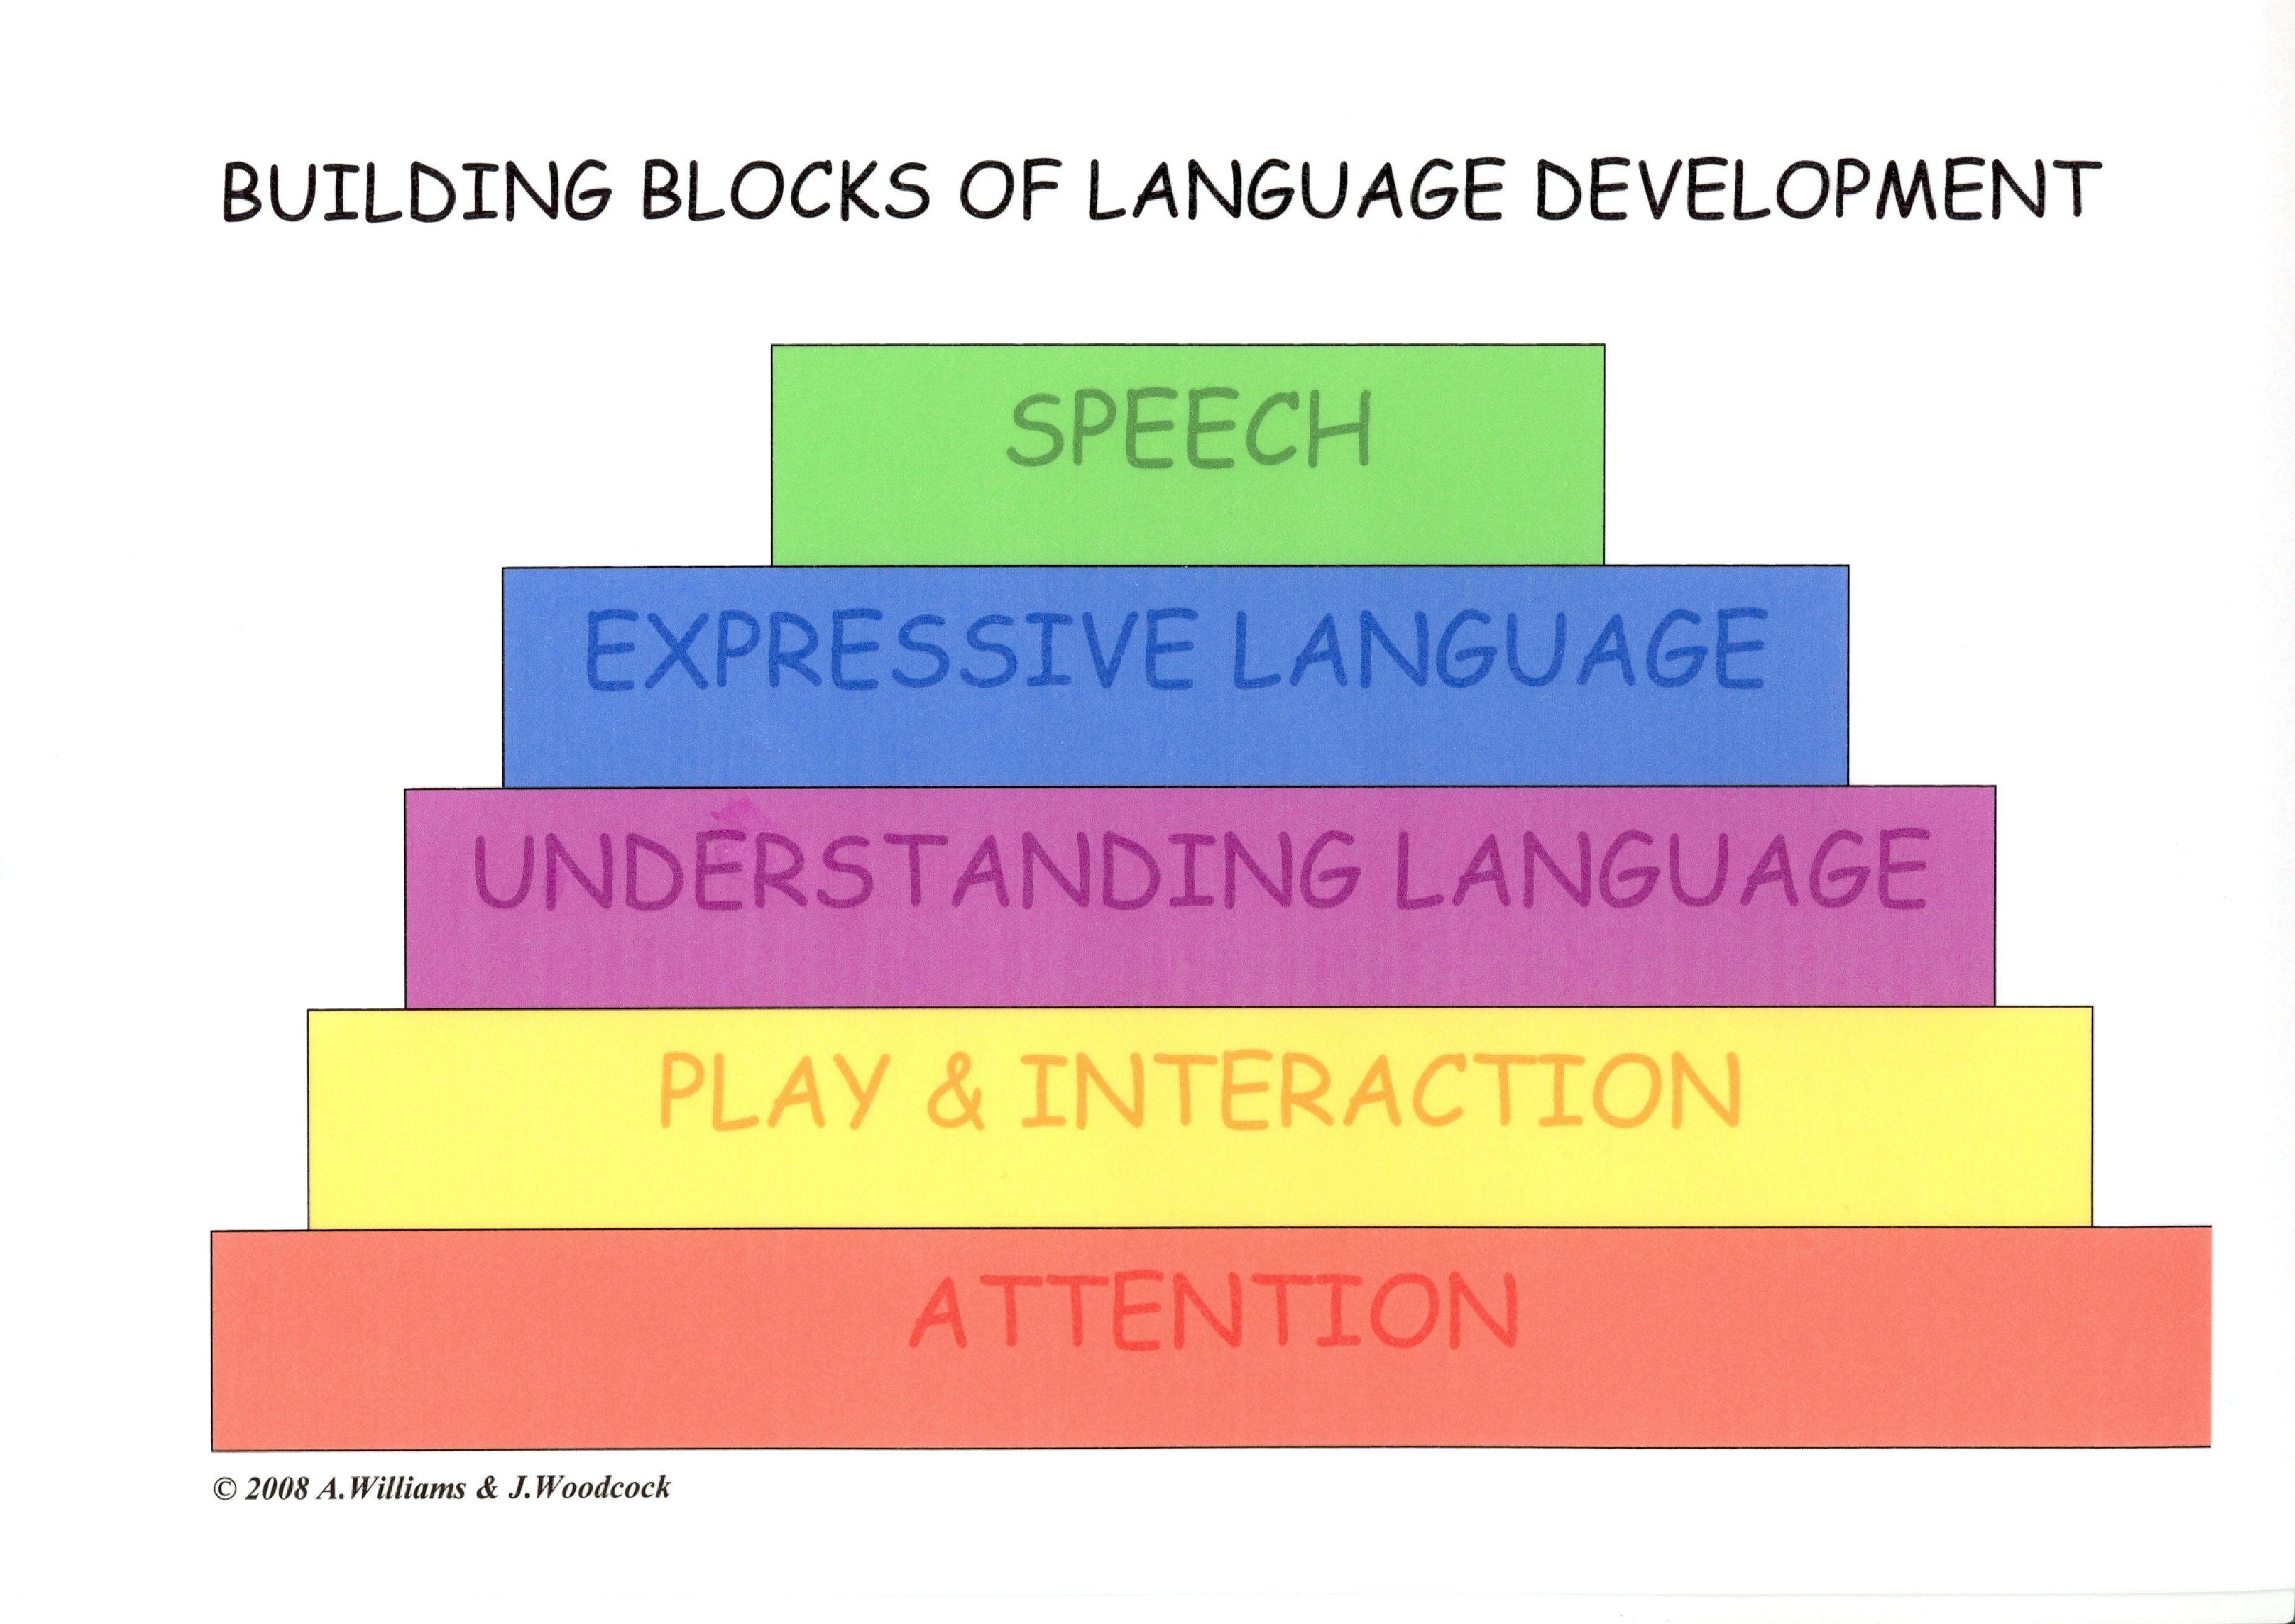

Slide 10
Developing good communication skills
Language development underpins all areas of learning and development including literacy, problem solving, thinking skills and making friendships.
Language development is not accidental, children need adults to help
Some children may have difficulties developing their language skills
Early identification of speech and language difficulties is crucial

Slide 11
Why?
To make relationships and have friendships
To learn – academic skills and social skills
To extend their thinking
For their self-esteem and confidence and eventually…
To get the job of their dreams and become independent!

Slide 12
What to expect by 4
Starting to like simple jokes.
Listens to longer stories and answers questions about a storybook they have just read.
Understands questions and commands with two parts eg ‘fetch your book and stand by the door’
Using longer sentences and linking sentences together
Understanding and using words describing colour, number and time
Can use 1000+ words
Most people will understand speech

Slide 13
What to expect by 5
Understands spoken instructions without stopping what they are doing to look at the speaker.
Understands more complicated language such as ‘first’, ‘last’, ‘might’, ‘may be’, ‘above’ and ‘in between’.
Understands 2,500 words and can use 1500-2000
Using long, well formed sentences – some grammatical errors still common
Can tell a story about own experiences
Uses most sounds except th/r, harder blends and multi-syllabic words

Slide 14

How to help

Slide 15
How to help at home (Top Tips)
Talking is a 2 way process, we need a partner!
Learning through play and everyday experiences (routines)
Special time
Get down to child’s level
Watch what they do
Commenting – see next slide

Slide 16
Avoid too many questions, ‘what’s that?’ (hand rule)
Avoid ‘say…….’
Look at books and sing nursery rhymes – rhyming stories are great!
Praise
Dummies and bottles
Screen time/TV
All of these strategies can be carried out throughout the day/ within your play and daily routines

Slide 17
Commenting
Reduce background noise and distractions
Get down to child’s level
Observe their play
Provide a commentary – name the toys/pictures/objects and describe what is happening
Use single words and short phrases
Repeat and add a bit more – expand by adding
Add actions and describing words
Provide a good model of speech sounds – children don’t have to copy you

Slide 18
More help
Children can also be referred to their local NHS SLT service
Many websites available for information and resources -
www.literacytrust.org.uk
Learning to talk | 3 to 5 years | Start for Life (www.nhs.uk)
Children's language development and parenting advice - BBC Tiny Happy People

Slide 19
Activities on tables
Feel free to try the activities with your children
We will be walking around modelling how to use them and feel free to talk to us and ask any questions you may have.

